Slide 1
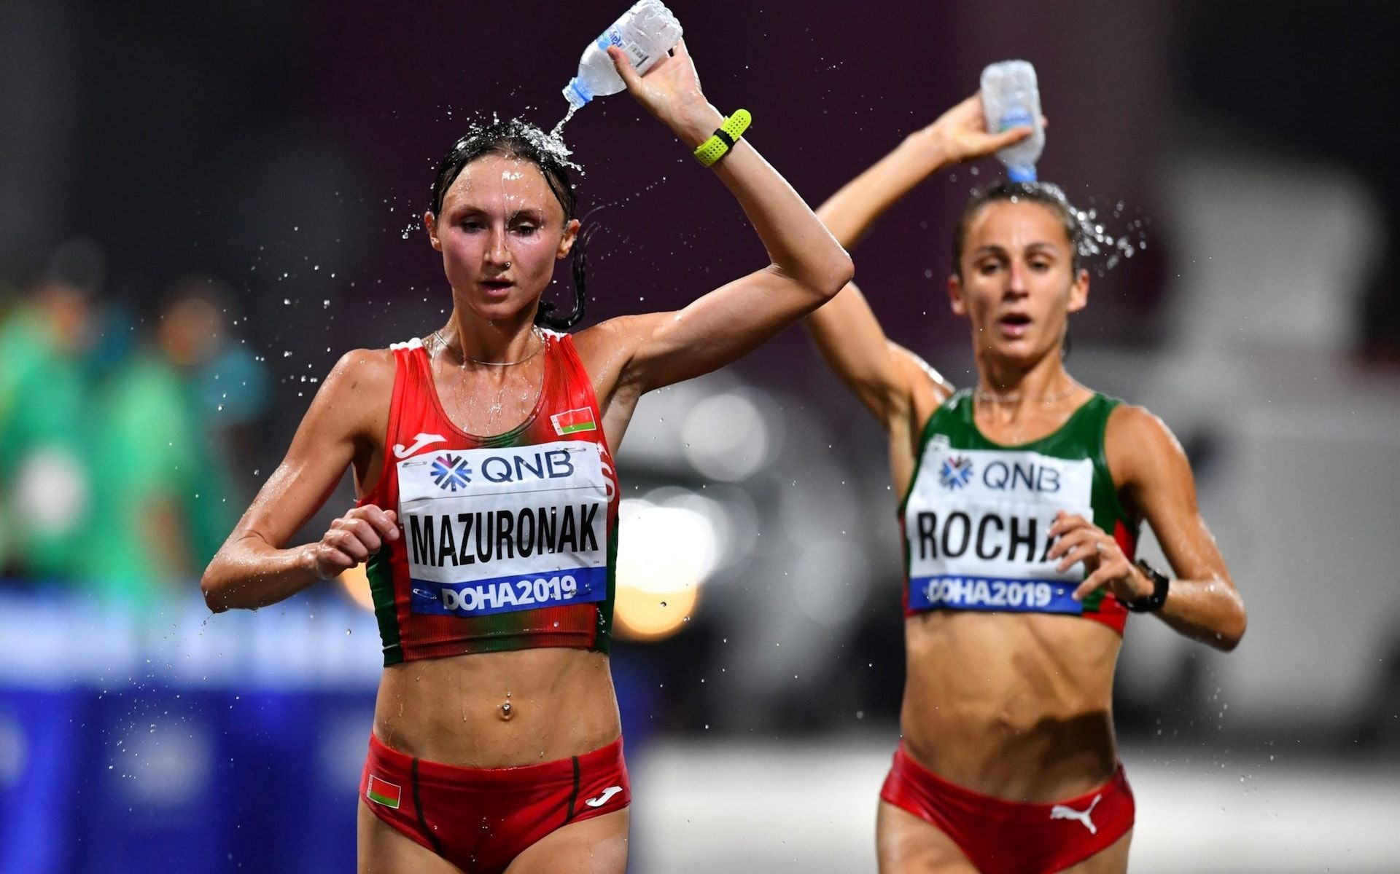
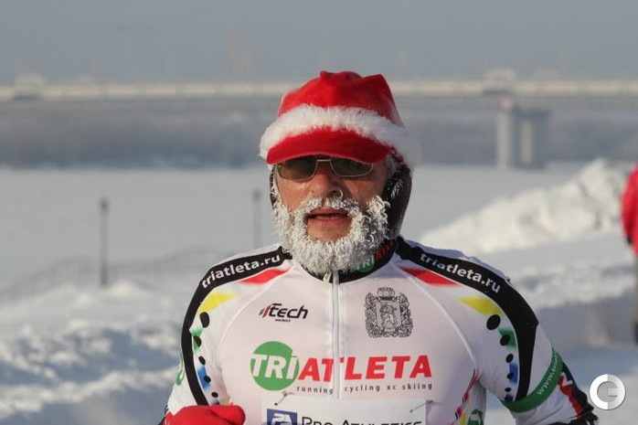
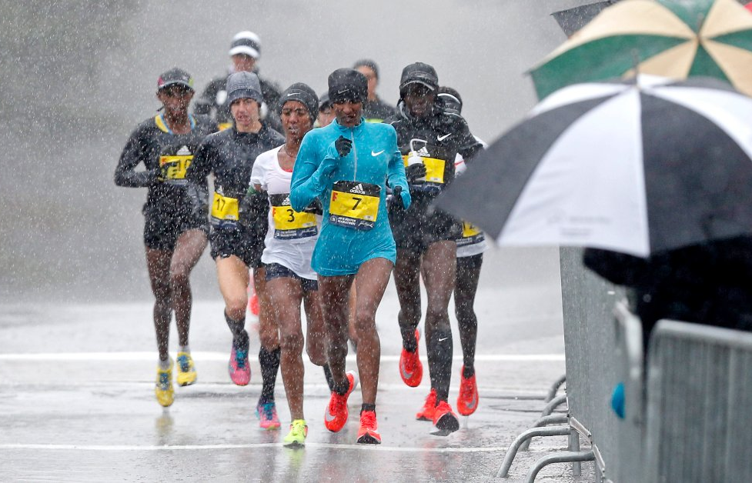
IMPACT OF WEATHER ON MARATHON PERFORMANCE ACROSS AGE AND GENDER
Brett Romano Ely, PhD
Assistant professor
Providence college

Slide 2
Impact of Weather on Marathon Performance
-Increasing WBGT results in slowing of marathon performance (Ely et al., 2007)
-Effects of weather less evident in female runners (Vihma, 2010)

Slide 3
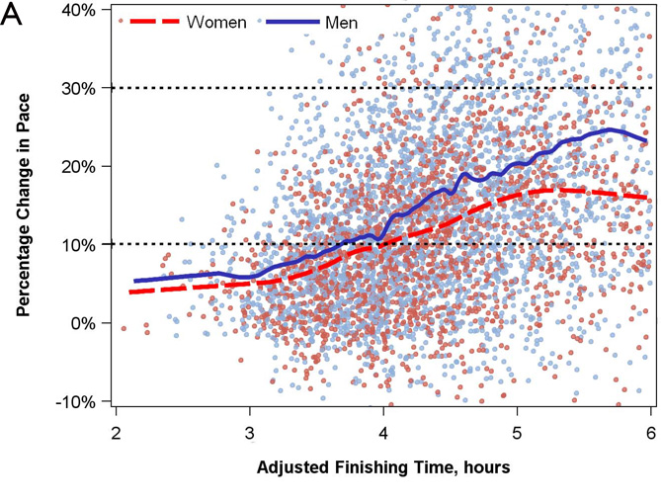
Gender, Age, and Marathon Performance
-Men are more likely than women to slow over the course of a marathon (Deanor et al., 2015)
-Older runners tend to have less pace variance in a marathon than younger runners (Nikolaidis, 2019)
-Masters men and women are negatively impacted by higher temperatures and humidity in the New York City marathon (Knechtle et al., 2021)

Slide 4
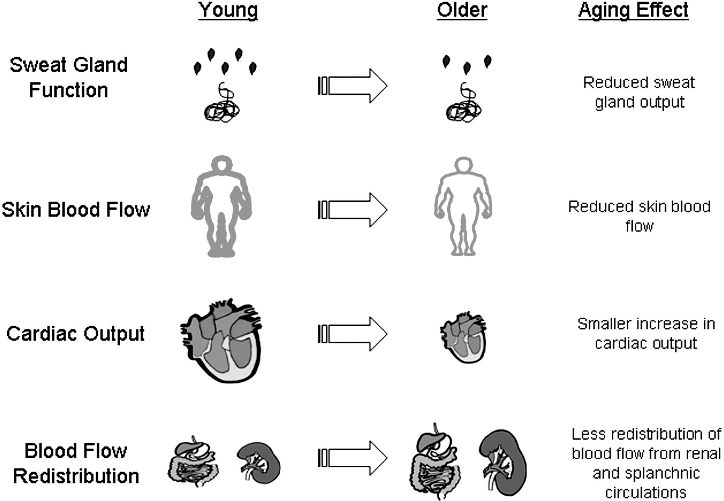
Impact of age on thermoregulation
Reduced ability to tolerate heat stress in older individuals
-Does this translate to decreased running performance in hot environments?
-Does it differ between men and women?
Kenney & Munce, 2003

Slide 5
Purpose
The purpose of this study was to examine the impact of weather (wet bulb globe temperature; WBGT) on marathon performance across the lifespan in both men and women.
Hypothesis: Slowing would be more pronounced with high WBGT in older individuals compared to younger individuals, and similar trends would be seen in men and women.

Slide 6
Methods
Marathon race results and weather data for: Boston, Chicago, New York, Twin Cities, Grandma’s Marathons for 17 to 24 years, 1993-2016.
Extracted fastest finishing time among men and women at each year of age, compared with the course record (%CR).
In preliminary analyses, races were divided into quintiles based on WBGT:
Q1: 0-5.0°C (1995 NYC, 5°C, 37%rh, WBGT =3.6 °C)
Q2: 5.1-10°C (2014 Twin Cities, 8.1°C, 55%rh, WBGT= 7.3°C)
Q3: 10.1-15 °C (2016 Boston, 13.8°C, 46%rh, WBGT =12.7 °C)
Q4: 15.1-20°C (2015 Grandma’s, 17°C, 87%rh, WBGT=18.1 °C)
Q5: 20.1-25°C. (2012 Boston, 24.5°C, 51%rh, WBGT=23.2 °C)
Regression analysis to model finishing time by age, gender, and WBGT.

Slide 7
Weather Parameters
Parameter | Coding details | Notes
Td, C | Dry bulb temperature in Celsius
Tw, C | Wet bulb temperature in Celsius | Factors in humidity
%rh | Percent relative humidity
Tg, C | Black globe temperature in Celsius | Factors in SR
SR W/m2 | Solar radiation in Watts per meter squared
DP | Dew Point in Celsius | Factors in humidity
Wind | Wind speed in Km/hr
WBGT | Wet Bulb Globe Temperature | Weighted average of dry bulb, wet bulb, and globe temperature
Flag | White = WBGT <10C Green = WBGT 10-18C Yellow = WBGT >18-23C Red = WBGT >23-28C Black = WBGT >28C | Based on WBGT and risk of heat illness

Slide 8
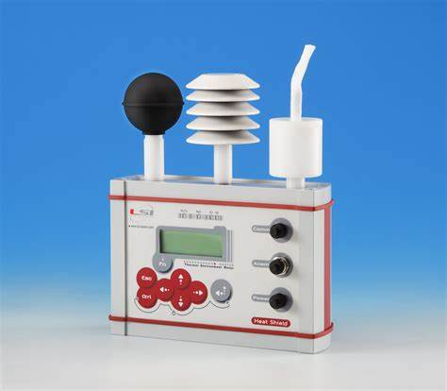
Calculating WBGT
WBGT = (0.7 * Tw) + (0.2 * Tg) + (0.1 * Td)
Td = Temperature, °C (dry bulb)
Tg = Globe Temperature °C, factors in solar radiation
Tw = Wet-bulb Temperature °C, factors in humidity

Slide 9
Results
Ninety-two race years yielded:
6,112 men finishers age 14 to 91
5,452 women finishers aged 14 to 88.
Preliminary Analyses:
A U-shaped relationship was found between age and %CR (R² = 0.792, p< 0.001), which was affected by gender (ΔR²= 0.012, p< 0.001).
WBGT also affected the prediction of %CR (ΔR²= 0.003, p< 0.001), with an impact of both age and gender.

Slide 10
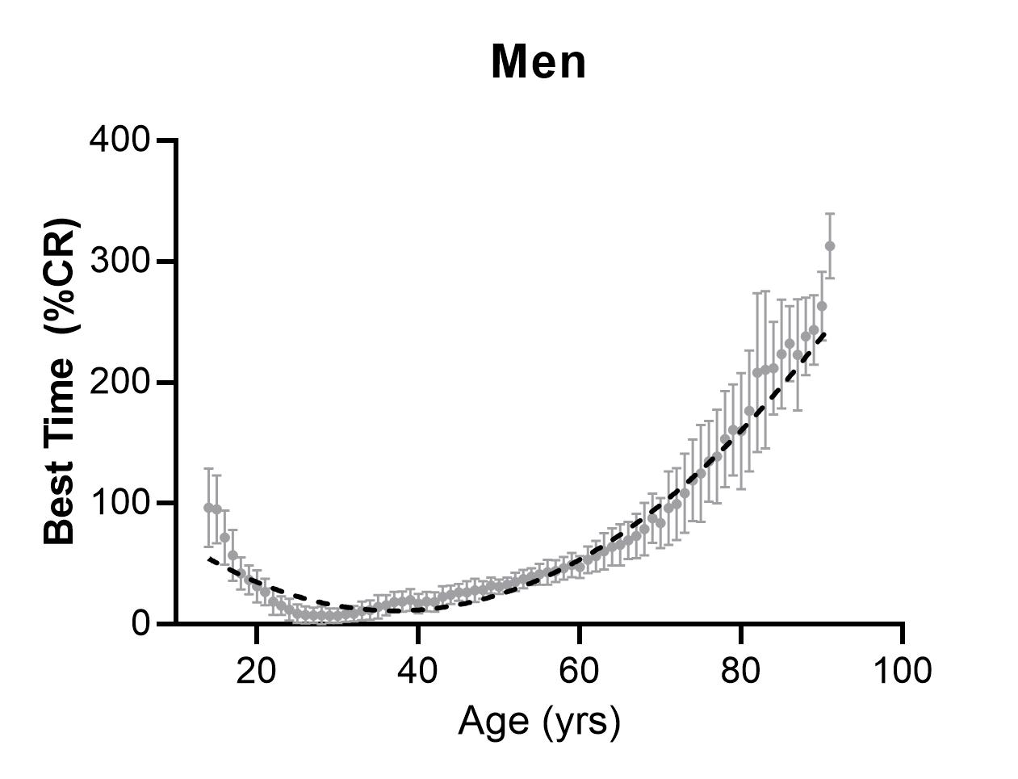
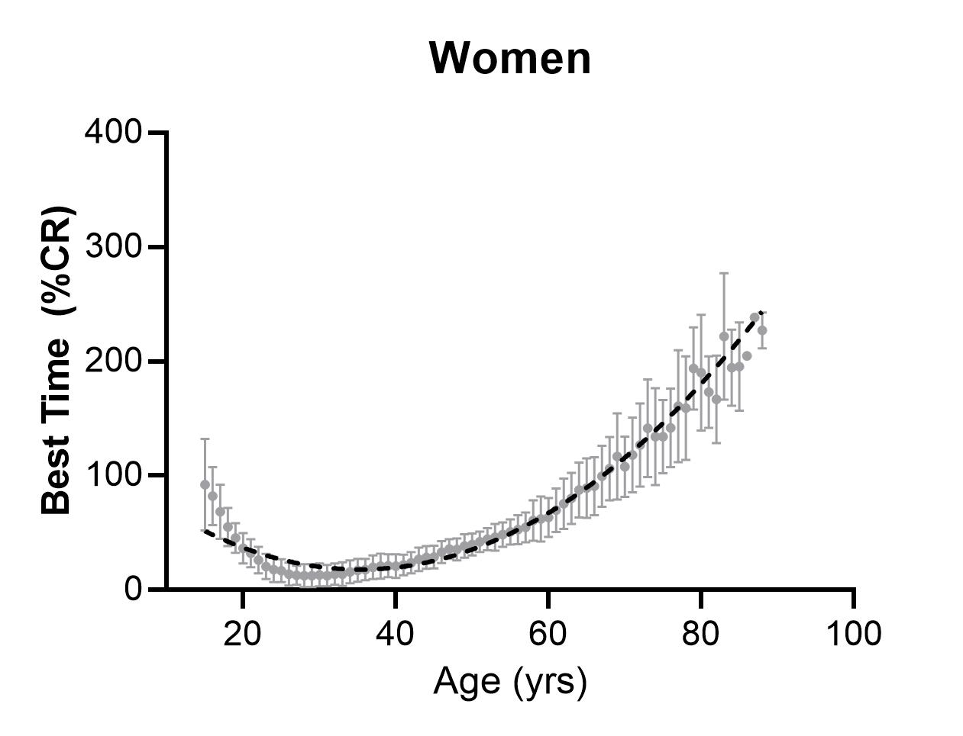
Men and Women Across Age

Slide 11
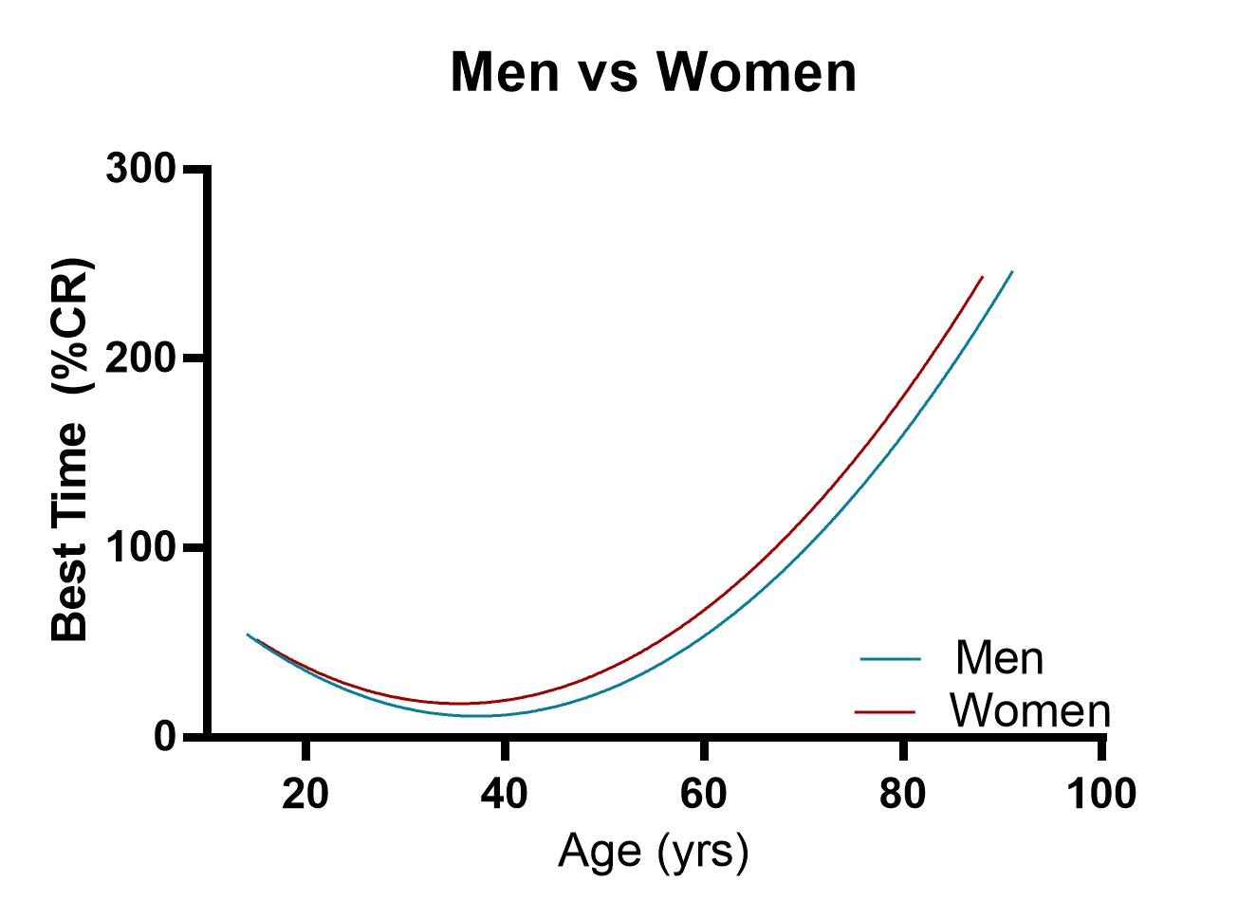
Curves are significantly different
Older women show accelerated
rate of slowing (equivalent of ~3 yrs)

Slide 12
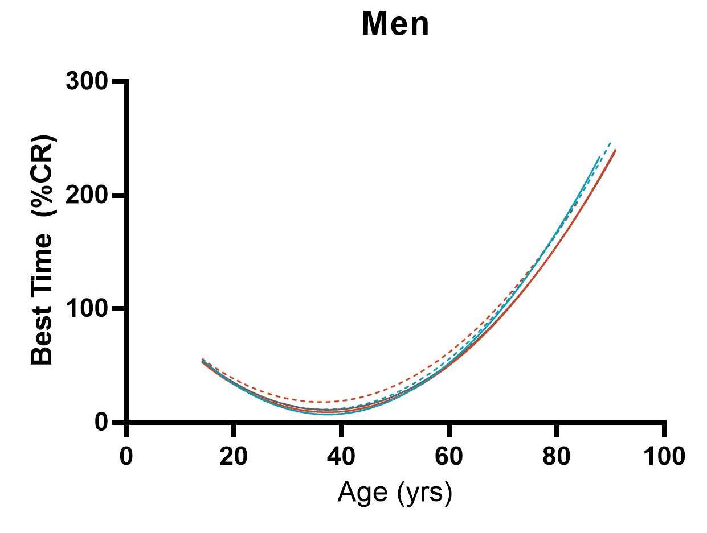
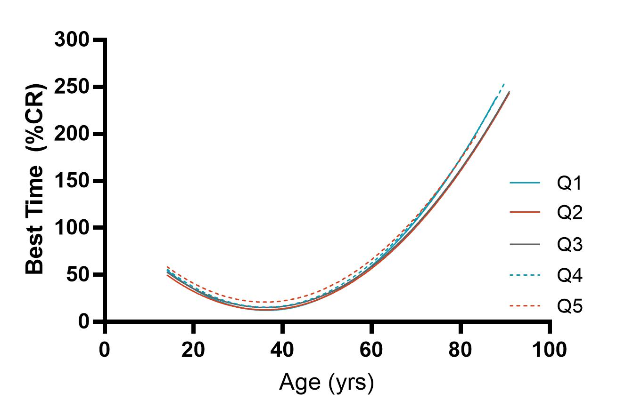
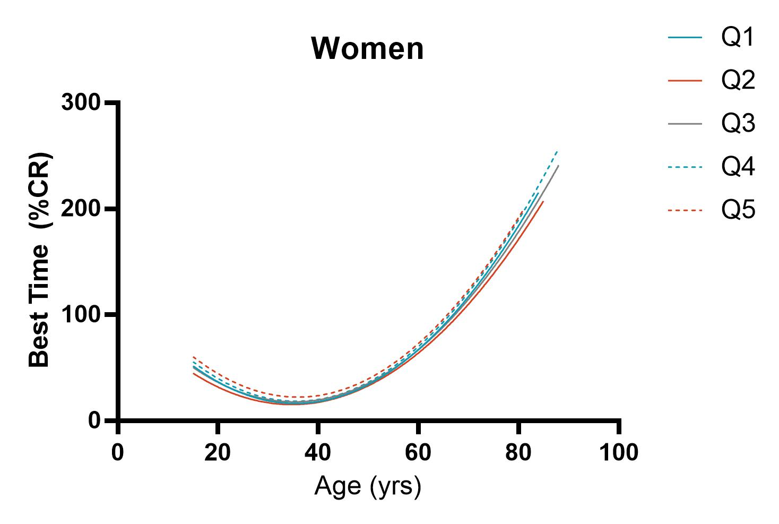
Impact of WBGT
Effects of WBGT were similar between men and women

Slide 13
Limitations & Future Directions
In preliminary analyses:
-Best-fit lines do not reflect ages of peak performance
-Unclear if WBGT categories or Flag conditions are the best way to “bin” data
-Youngest and oldest runners have more limited dataset
Future Directions:
-Aging: At what age do men and women run their fastest marathon? At what age does slowing become significant?
-Weather: which variables are most highly related to performance? Does the impact of weather differ across age and gender?
Air Quality: These data have not been explored, but previous work indicates air quality may affect women more than men (aging not examined yet)

Slide 14
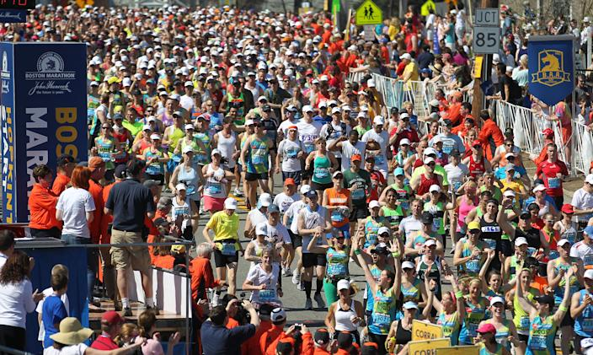
Questions/Discussion

